Slide 1
From values to principles
From values to principles to guidelines
– the ongoing challenges for Palliative care
Professor Simon Woods (Emeritus)
Notes:
FIXED Image / Presentation title slide.
Insert title and sub-deck as required to start your presentation.
`1234567890-=qwertyuiop[]asdfghjkl;’#\zxcvbnm,./
¬!”£$%^&*()_+QWERTYUIOP{}ASDFGHJKL:@~|ZXCVBNM<>?

Slide 2
Introduction
From values to principles
The ambition of palliative care
Thinking through the challenges
Lessons from the Liverpool Care Pathway
I was thirsty and you gave me to drink –
      Reflecting on ethics and values
Systems approach
  Where is palliative care in all of this?
Questions
Notes:
BLANK SLIDE
To duplicate slide, select copy on tool bar and then duplicate on drop down menu.

Slide 3


Strategies for thinking
Individual – you as a practitioner
Institution
Societal (sytems)

Slide 4
AREA model
Anticipate
Reflect
Engage
Act
Anticipate
Anticipating the impacts, intended or otherwise, that might arise.
Reflect
Reflect on the purposes of, motivations for and potential implications of the innovation, together with the associated uncertainties, areas of ignorance, assumptions, framings, questions, dilemmas and social transformations these may bring.
Engage
Open up to broader and inclusive deliberation, dialogue, engagement and debate.
Act
Acting to influence the direction and trajectory of the innovation process..

Slide 5
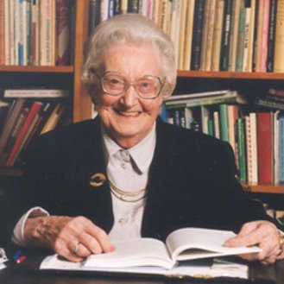
The ambition of palliative care
From values to principles
You matter because you are you, and you matter to the end of your life. We will do all we can not only to help you die peacefully, but also to live until you die.​
Saunders​
Mainstream healthcare failing the dying​
Needed to take the patient out in order to allow values back in​
Hospice as a special place ‘a resting place for pilgrims'

Slide 6
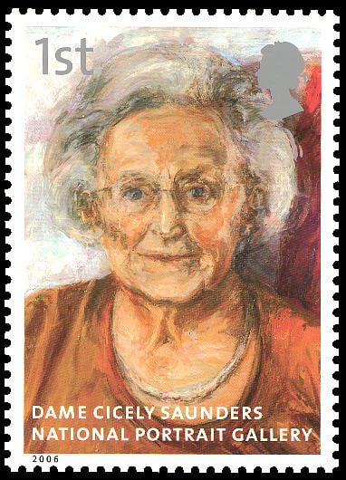
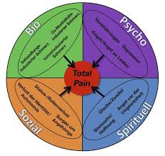
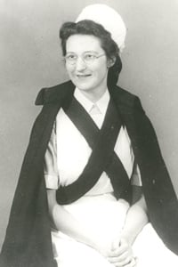
From values to principles
You matter because you are you, and you matter to the end of your life. We will do all we can not only to help you die peacefully, but also to live until you die.​
Saunders​

Slide 7

The ambition of palliative care
From values to principles
Danish Hospice managers:
‘love’, ‘authenticity’, ‘compassion’, ‘altruism’, ‘spirit of openness…’, ‘presence’ Compassionate care and the associated virtues were seen as a necessary part of hospice identity. (Graven et al 2021)
4 drivers:
Move towards an evidence-based practice
Conscious engagement with values in the care of the dying – e.g., ‘open awareness’
Move from passive to active forms of care
Holistic approach to care (Clark 1998, Woods 2007)

Slide 8
The ambition of palliative care
Hospice
Palliative care
Quality in dying and a good death for all

Slide 9
The ambition of palliative care
Therapeutic ratio
Palliative Care
Cure
Death
Curative treatment
‘upstreaming’ palliative care

Slide 10

The Liverpool Care Pathway
The introduction of the Liverpool Care Pathway for end-of-life care into acute hospitals in the UK was an attempt to extend palliative care beyond hospices and specialists into routine care in acute hospitals.
It failed but taught lessons that are broadly applicable.
First published in the late 1990s and was an integrated care pathway detailing standardised care to be delivered to dying patients and their families.
It went through 12 revisions before it was abolished in 2013.
‘Liverpool’ because it came from the Liverpool Marie Curie Centre
From values to principles

Slide 11
LCP
… promotes the spread of the palliative care approach in the dying phase to members of the generic team. In this way, it has the potential to impact on the ‘culture’ of the delivery of care to dying patients in a way that a relatively small team of palliative care professionals … could probably never do (p198).

Slide 12
LCP – last days or hours of life
Non-essential drugs should be discontinued.
Essential drugs converted to the subcutaneous route
Inappropriate interventions, including blood tests etc. discontinued
Artificial fluids in the dying patient is of limited benefit and should in most cases be discontinued
Patients who are in the dying phase should not be subject to cardiopulmonary resuscitation
Communication with patient and close ones.
(Ellershaw and Ward 2003:32) ​

Slide 13
LCP – 3 main failings
1. It was assumed that what worked in hospices—institutions dedicated to care of dying people and staffed by highly skilled practitioners—could work in busy NHS hospitals with different priorities and lacking staff skilled in end-of-life care.
2. It was implemented with little or often no training, and consequently many of its actions were reduced to a “tick-box exercise” and a “one-size-fits-all solution” and became a target incentivized by money.
3. It severely lacked the research evidence that is expected in the adoption of any other new health technology.

Slide 14
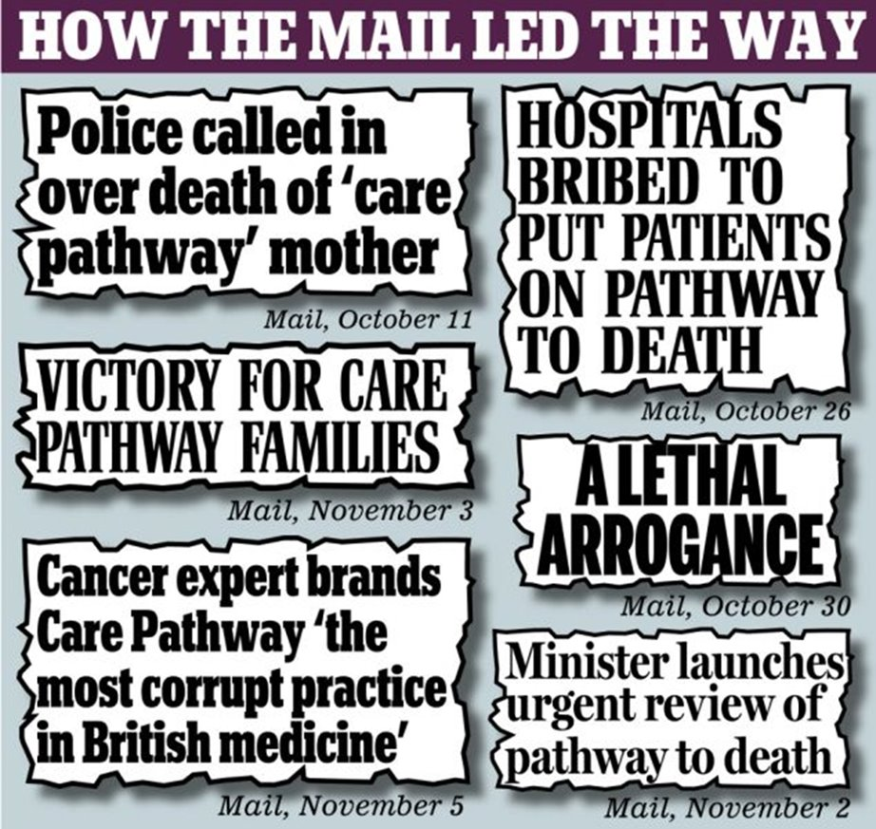
LCP
From values to principles
Public reaction
Loss of public faith
Media ‘influence’
First negative publicity for palliative care
The review panel heard of many instances of patients being denied food and drink because they were on the ‘pathway’.
several newspapers reported ‘horror’ stories

Slide 15

LCP
From values to principles
Guidelines on end-of-life care do have a place
But they need to be based on high quality evidence
Should be introduced with training and regular audit
Should not be financially incentivised.
Don't just read the guidance, and particularly do not just use the checklist. Engage your brains and your hearts, read and implement evidence-based guidelines, and that is what will improve care.

Slide 16
AREA model
Anticipate
Reflect
Engage
Act

Slide 17
I was thirsty and you gave me to drink (Matthew 25:35)
Jeg var tørstig, og du gav mig noget at drikke
From values to principles

Slide 18

Three questions
Could this ever happen in your place of work?
How have you learned what you have learned – why is it obvious (indlysende) ?
How would you make it obvious to someone who couldn’t see it?

Slide 19
Death systems: Lancet Commission on the Value of Death. (2022)
From values to principles
Warning and predicting death
Preventing death
Caring for dying people
Disposing of dead people
Social consolidation after death
Making sense of death
Killing
The increased number of deaths in hospital means that ever fewer people have witnessed or managed a death at home. This lack of experience and confidence causes a positive feedback loop that reinforces a dependence on institutional care of the dying.
Robert Kastenbaum: Defined Death Systems as:
‘interpersonal, socio-physical and symbolic networks through which an individual's relationship to mortality is mediated by society’
Death systems are the means by which death and dying are understood, regulated, and managed.

Slide 20
Three questions
Who comes into hospices?
How do they get there?
Why do they come to hospices?

Slide 21
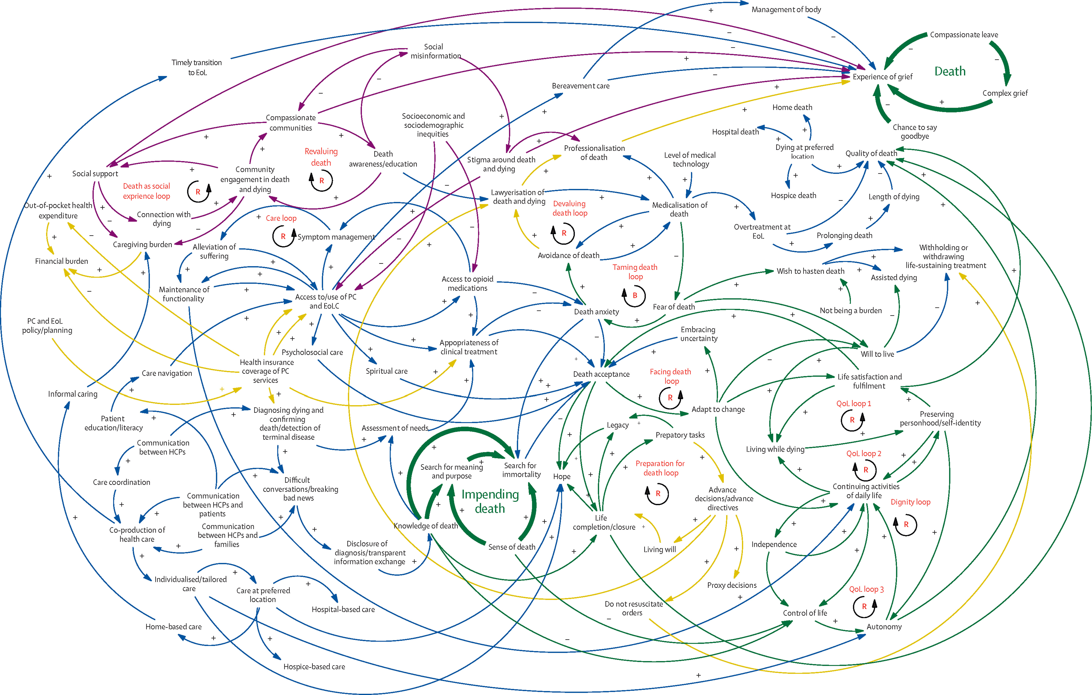

Figure 3
The Lancet 2022 399837-884DOI: (10.1016/S0140-6736(21)02314-X)
Copyright © 2022 Elsevier Ltd Terms and Conditions
Notes:
An example of a dynamic map of an end-of-life system
EoL=end of life. HCPs=health-care providers. PC=primary care. QoL=quality of life. R=reinforcing loop. B=balancing loop.

Slide 22
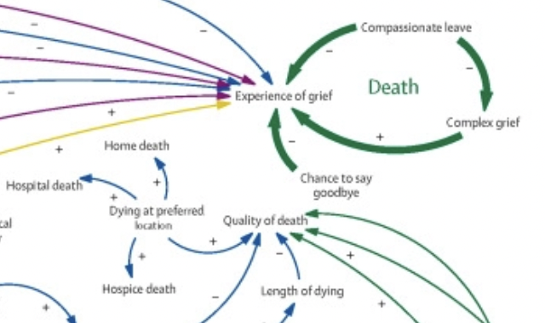

Slide 23
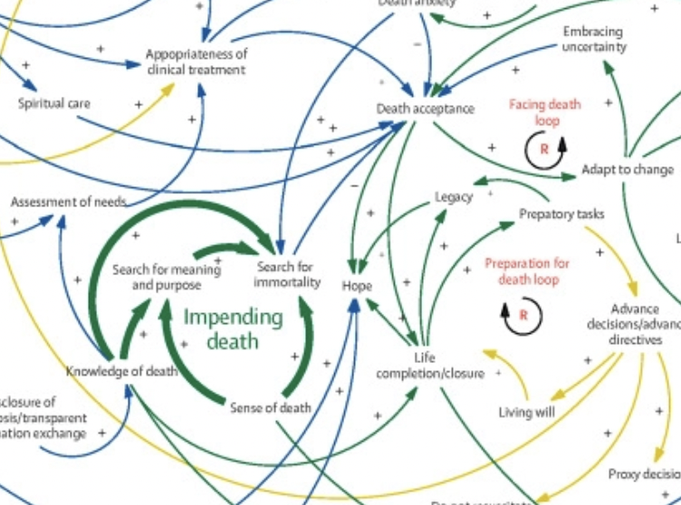

Slide 24
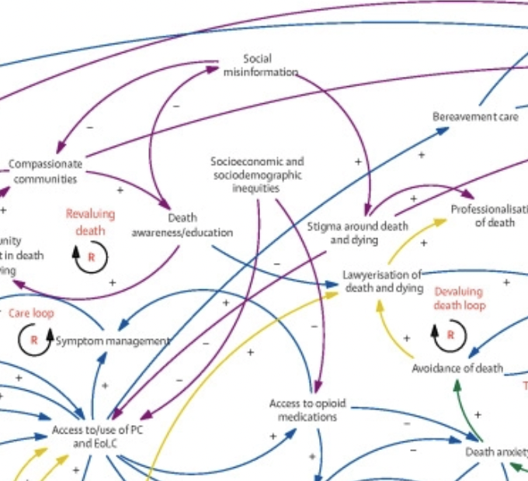

Slide 25
Figure 3
The Lancet 2022 399837-884DOI: (10.1016/S0140-6736(21)02314-X)
Copyright © 2022 Elsevier Ltd Terms and Conditions
Notes:
An example of a dynamic map of an end-of-life system
EoL=end of life. HCPs=health-care providers. PC=primary care. QoL=quality of life. R=reinforcing loop. B=balancing loop.

Slide 26
Learning from death systems
One of the enigmas of death is that although mortality is universal death systems are dynamic and evolving – what does this mean for palliative care?
Power flows through systems – who and how can it be managed?
Social determinants of death – not just referral but social factors
Intersectionality – factors that cross over (intersect) can create advantage and disadvantage

Slide 27
AREA model
Anticipate
Reflect
Engage
Act
Taking the person ‘out’ – hiding death?
Increasing the inequality of dying?
Changing nature of dying
Medicalisation
De-skilling of carers
What is the new modern hospice?
How to realise the palliative care ambition?
What do we know and don’t we know?
Who are we engaging with?
Which voices are heard?
What do people want from EOLC?
  Compassionate communities
  Euthanasia and PAD
Activists or stoics?
Government or community
Individual

Slide 28
Concluding thoughts
Reflection is integral to professional life – the AREA tool is one useful way to do this
Palliative care needs to be responsive because death and dying are themselves in a dynamic system
Systems thinking opens a wider arena in which palliative care is located

Slide 29
tak fordi du tænkte med mig

